Slide 1
4th Grade
Back to School Night
Teachers:
Mrs. Feaster
Mrs. Hendershot
Mrs. Ogden
Mrs. Sansom
Welcome to the 2017-2018

Slide 2
School Start Time
9:25 am
Students should not enter the building until 9:20 am.
There is no supervision before 9:20.
Students will enter the classroom at 9:25.
Late arrivals must be signed in at the front office.
If your child is absent, please send in a note or email so that it can be an excused absence.
Please notify teacher of any medical concerns in writing.
Notes:
Angel

Slide 3
4th Grade Schedule 2017-2018
 |  | Monday | Tuesday | Wednesday | Thursday | Friday
9:35 – 11:00 |  | Reading/ Language Arts | Reading/ Language Arts | Reading/ Language Arts | Reading/ Language Arts | Reading/ Language Arts
11:00 – 11:30 |  | Writing | Writing | Writing | Writing | Writing
11:35-12:20 |  | Specials Hendershot – ART Feaster – MUSIC Ogden – PE Sansom - Media | Specials 4th Grade Chorus | Specials Hendershot – PE Feaster – ART Ogden – MUSIC Sansom - MUSIC | Specials Ogden – ART Sansom – PE Feaster – MEDIA Hendershot - MEDIA | Specials Hendershot – MUSIC Feaster – PE Sansom – ART Ogden - MEDIA
12:25-1:00 |  | Lunch | Lunch | Lunch | Lunch | Lunch
1:00 – 1:35 |  | Recess | Recess | Recess | Recess | Recess
1:40 – 3:10 |  | Math | Math | Math | Math | Math
3:10 – 3:40 |  | Science / Social Studies | Science / Social Studies | Science / Social Studies | Science / Social Studies | Science / Social Studies
3: 45 |  | Dismissal | Dismissal | Dismissal | Dismissal | Dismissal
Notes:
Angel

Slide 4
Universal Breakfast Guidelines
Do the students have to take all items?
Students must take the main food item and one serving of fruit. EXAMPLE: Any of the following would be an allowable “breakfast”:
Pancakes & Juice(fruit)/Pancakes, Milk & Juice(fruit)
PLEASE do not send in breakfast from home.
Notes:
Gina

Slide 5
Birthdays
Students birthdays will be announced on the morning announcements. Students will receive a birthday pencil from the office.
We can not pass out birthday treats in the classroom or lunchroom.
Notes:
Gina

Slide 6
Instrumental Music
Wednesday and Thursday
Fourth Grade Chorus
Tuesdays 11:35-12:20
Notes:
Gina

Slide 7
Chrome Books
*All grade 4 students will be issued a chrome book to use at school.
*They are expected to stay on MCPS approved sites at all time.
*Students will have a google account and can access assignments at home from GOOGLE CLASSROOM.
Notes:
Shagala

Slide 8
Field Trips
October 19th Close Encounters With Agriculture
October 24th National Aquarium
Parents must complete Child Abuse and Neglect training on the computer and return it to the classroom teacher prior to chaperoning a field trip.
(September 22, 2017)
Notes:
Shagala

Slide 9
Homework
Reading: 4th graders are asked to read 20 minutes or more each night with a book on their reading level.
Math: Math homework will be given 2-4 times a week (AS NEEDED)
I-Ready Reading: 45 minutes weekly
I-Ready Math: 45 minutes weekly
Students will also have the opportunity to complete I-Ready in the classroom.
Other: Instrumental music students may need to take home work to finish that they miss during class time.
Notes:
Shagala

Slide 10
If you are looking for additional learning opportunities for your child to complete at home, please check out the fourth grade website. Click on Media Center for a variety of links to educational websites, Brain Pop, and Capstone Books. Children also enjoy going to the public library with their family.
Notes:
Bridget

Slide 11
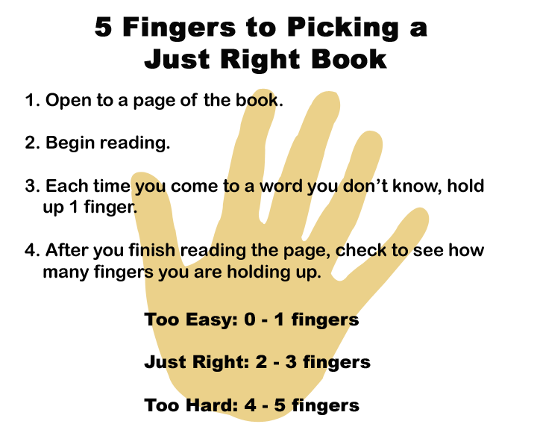
Notes:
Bridget

Slide 12

Traveling Folder
Free Choice Friday
Students earn 10-20 minutes of
free time based on weekly behavior.
Monthly Super Stars
Students who demonstrate
Star behavior the entire month
Will be invited to attend a
monthly fun activity.
Traveling Folder
Notes:
Gina

Slide 13
Measurement Topics in Grade 4 Reading
Literary Text
Informational Text
Language Vocabulary
Notes:
Angel
Indicators for student learning are organized into Measurement Topics. Students are evaluated each marking period in three different areas of reading:
Literary Text
Informational Text
Language Vocabulary
Students are evaluated in reading based on their understanding of text at their individual instructional level for both the literary and informational measurement topics.

Slide 14
Writing Measurement Topics
Narrative
Informative
Opinion
Process, Production, and Research
Use of Language
Notes:
Angel
Measurement Topics are categories of content and processes that students should know and be able to do. There are five Measurement topics in writing on which students are assessed: Narrative, informative, Opinion, Process, Production, and Research, and Use of Language. These Measurement Topics have been aligned with the Common Core State Standards. Measurement topics are reported on each marking period.

Slide 15
Science Units
Ecosystems
Erosion
Electricity
Notes:
Shagala

Slide 16
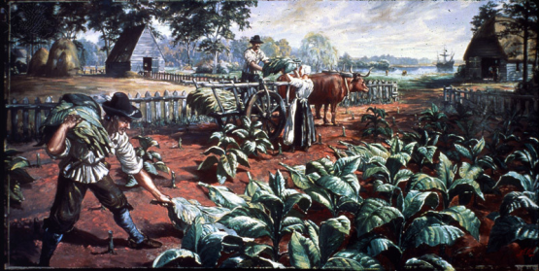
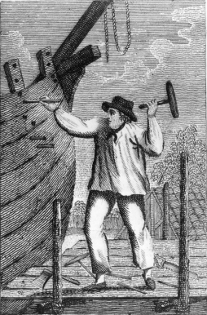
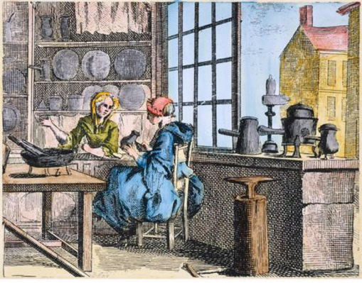
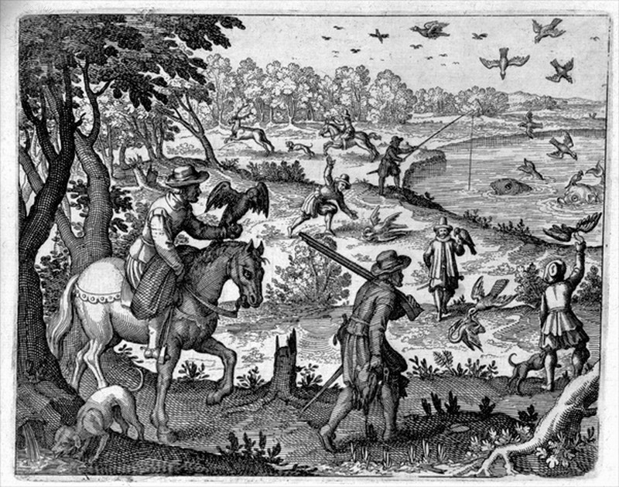
Civics
Economics
History
geography
Notes:
Shagala
n weeks 4 through 9, students gather, record, and analyze information about how colonists lived and worked in the three regions of colonial America. Students first determine how power with authority was established in the Maryland colony through proprietorship and the establishment of law. Portions of the Maryland Charter, Maryland State Constitution, and a variety of acts are explored. Students then conduct a regional study of colonial America.

Slide 17
Donations Gladly Accepted ☺
Aluminum Foil
Clean Clear Two Liter Soda Bottles
Scrapbook Paper (any size)
Playdough
Used Legos
Uno Cards
Jenga Blocks
Notes:
Gina

Slide 18
How Parents/Guardians Can Help
Review Friday Folder papers
Remove graded papers
Sign learning skills sheet
Monitor nightly reading using a just right book
Check homework and agenda book nightly
Bring in clean, empty and clear 2-liter bottles with the caps
Notes:
Bridget

Slide 19
Ways to Communicate with your child’s teacher
Written Notes
Friday Folder
Phone calls (301-989-5654)
Email (Burtonsville Website)
Notes:
Angel

Slide 20
Fourth Grade Updates
To find the latest fourth grade information check out our fourth grade Twitter Page
Search: @Burtonsville4th
Notes:
Bridget

Slide 21

Thank
you
for
coming!
Mrs. Feaster
Mrs. Hendershot
Mrs. Ogden
Mrs. Sansom

